Slide 1

The pet benefits
you’ve been wishing for
2027 Plan Year

Slide 2


Your pet benefit offerings
Discounts on veterinary care
Discounts on pet food,
prescriptions, and more
Maximize your pet care savings by enrolling in both plans!

Slide 3
Why pet benefits

Slide 4
Pets are family
45%
65%
44%
of pet parents spend as much or more money for their pets' health expenses as their own
of pet owners spoil their pets daily, with over half spoiling their pets "24/7"
of pet owners celebrate their pet's birthday with a birthday bash
BPM
Zesty Paws
Zesty Paws
Your pets are part of your family, and you’ll do anything to keep them happy and healthy.

Slide 5

Pet care costs grew ~70% in two years
$800-$1500
average emergency vet bill
$2000
average spent per pet per year
(not including emergencies)
It's harder than ever to afford quality veterinary care –
with 63% of pet parents not prepared for a
$500 emergency expense
Global market insights from 2020-2022, CNBC

Slide 6
Pet Assure
Affordable care for every pet family

Slide 7

PET ASSURE
Veterinary discount plan
All pets are eligible, even elderly pets and pets with pre-existing conditions
Participating veterinarians in all 50 states and Puerto Rico
Use as an alternative or addition to pet insurance
Includes 24/7 Lost Pet Recovery Service from ThePetTag
Single Pet: $8/month
Family Plan (2+ Pets): $11/month

Slide 8
PET ASSURE
How it works
Access your digital ID card through the Pet Assure app
Show your card to any participating veterinarian
Receive an instant 25% discount on all in-house medical services at every appointment
It’s as simple as that!
Pet Assure is not insurance. It’s a discount that your vet gives at the time of service. There are no forms to fill out, no waiting for reimbursements, and no denials of coverage.

Slide 9
PET ASSURE
Lost pet recovery service
All pets with a collar are eligible to receive an ID tag
If your pet goes missing, the finder scans the tag to access the information you provide in your online profile
No special scanners necessary, just a smartphone
Instantly update contact information online, even after your pet goes missing

Slide 10
PetPlus
Quality products for your pet. Savings for you.

Slide 11
PETPLUS
Pet product discount plan
Receive members-only pricing (up to 40% off) on your pet’s prescriptions, preventatives, food, treats, and more
Shipping is always free
Most prescriptions can be picked up at participating pharmacies, including CVS, Walmart, and other independent CVS Caremark® pharmacies
All dogs and cats are eligible, regardless of age, breed, or health
Single Cat/Dog: $3.50/month
Family Plan (2+ Cats/Dogs): $7.50/month

Slide 12
PETPLUS
How it works
Shop Online
Shop for your pet’s favorite products at PetCareRx.com
Savings are automatically applied at checkout and shipping is always free
PetPlus will confirm prescriptions with your vet on your behalf
Pick-up In Store
Ask your vet for a written prescription for your pet’s medication
Present your pet’s prescription and PetPlus Rx card at any network pharmacy
The pharmacist will fill your pet’s prescription and PetPlus will charge your credit card on file at the listed member rate

Slide 13
PETPLUS
24/7 pet telehealth
Included with every PetPlus membership
Connect with a vet 24 hours a day
Staffed exclusively by licensed veterinarians
Receive answers to urgent questions about your pet’s health, wellness, behavior and more
Reduces unnecessary vet visits
No out-of-pocket costs or extra fees

Slide 14
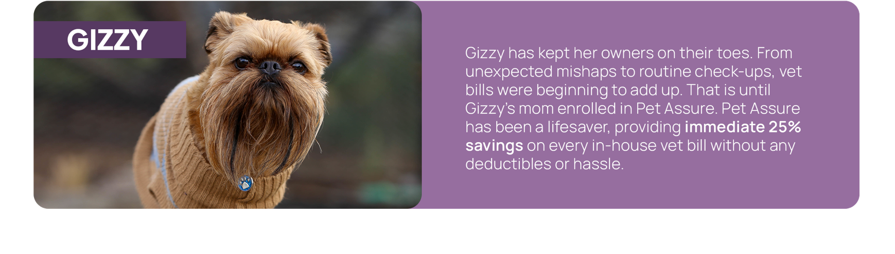

Pet Assure makes saving easy

Slide 15
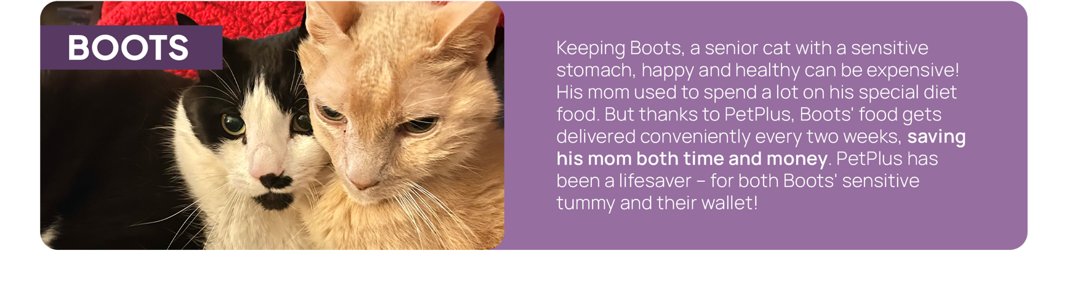

Enjoy big savings with PetPlus

Slide 16


Enroll in pet benefits today
Discounts on
veterinary care
Discounts on food,
prescriptions, & more
ENROLL: https://app.wishbone.pet/land/spxcorporation
QUESTIONS: help@wishbone.pet | (800) 887-5708

