Slide 1





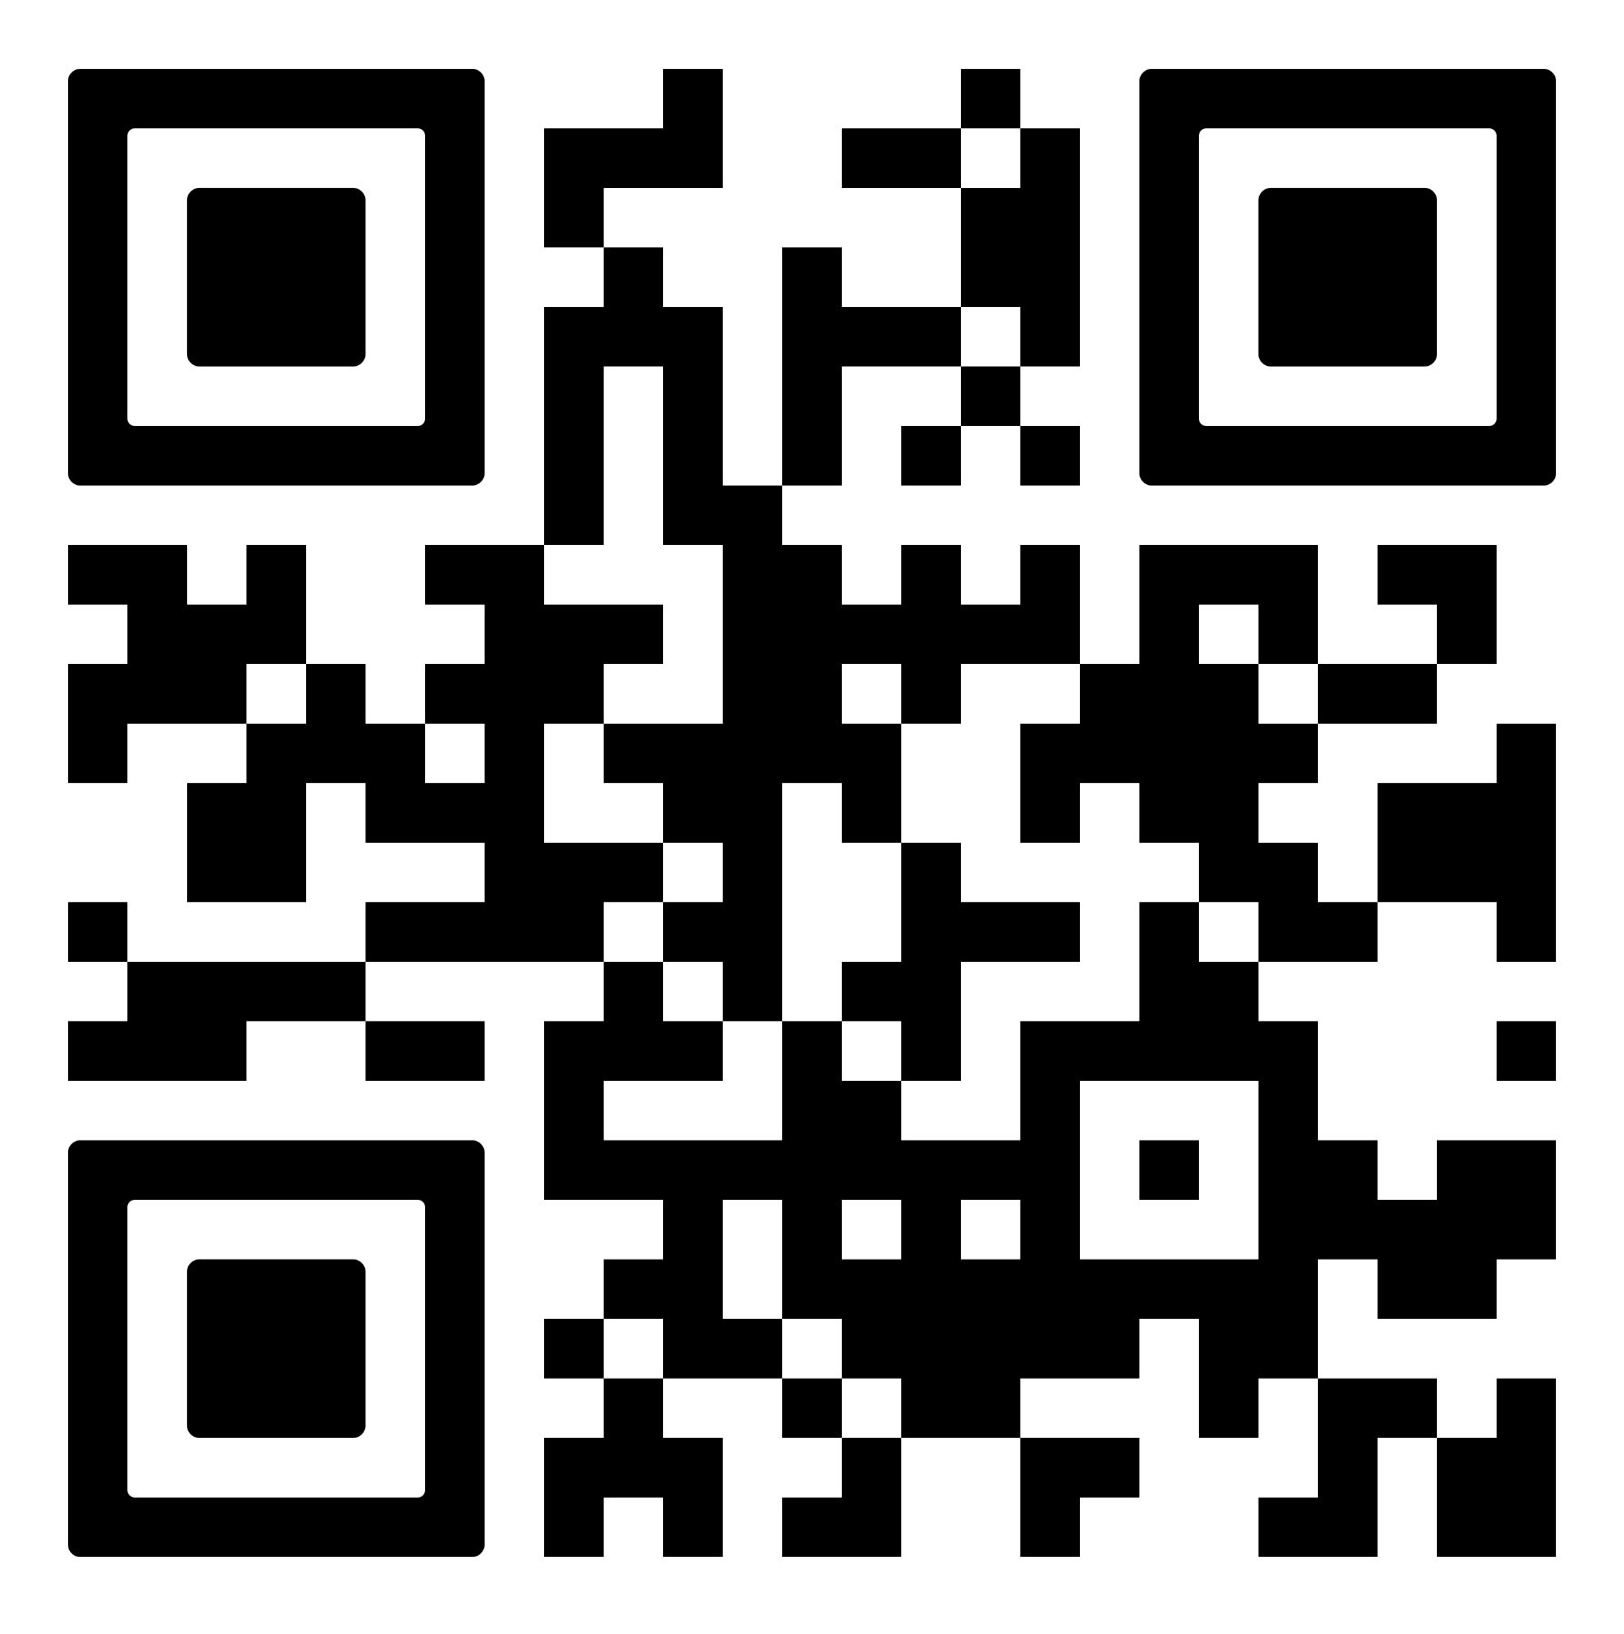
WELLNESS
YOUR WAY
DOWNLOAD THE MOBILE APP
Search for the WellRight App in the iOS App Store or Google Play Store.
Log in with the same email and password you use on the web.
Access all of the platform features no matter where you are.
Complete the health assessment
Track your activity progress
Set up text tracking
Sync a fitness device
View your Health Profile
Complete a University course
Add a personal challenge
Review your Summary Report

