Slide 1


Perfect balance
Health care for the whole you
SPX ENTERPRISES
    October 2024
Aetna is the brand name used for products and services provided by one or more of the Aetna group of companies, including Aetna Life Insurance Company and its affiliates (Aetna).
Information is believed to be accurate as of the production date; however, it is subject to change. Actual results may vary.
©2023 Aetna Inc.
XXXXXXXXXX (X/23)
Notes:
Remember to delete the Plan Sponsor logo placeholder.

Slide 2

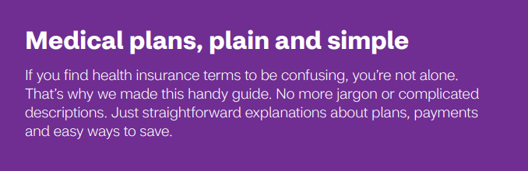

Slide 3



Get the coverage you need
with the Aetna Choice® POS II health plan
In-network and
out-of-network care
Preventive care
No referrals required
Preapproval for
some services
Lower out-of-pocket
costs for
in-network care
Check the plan design and benefits summary for more information on coverage and costs.
Notes:
With your Aetna Choice® POS II health benefits plan, there’s no guessing or tricky decisions. To get quality care — and lower out-of-pocket costs — all you need to do is stay in your network.

Slide 4
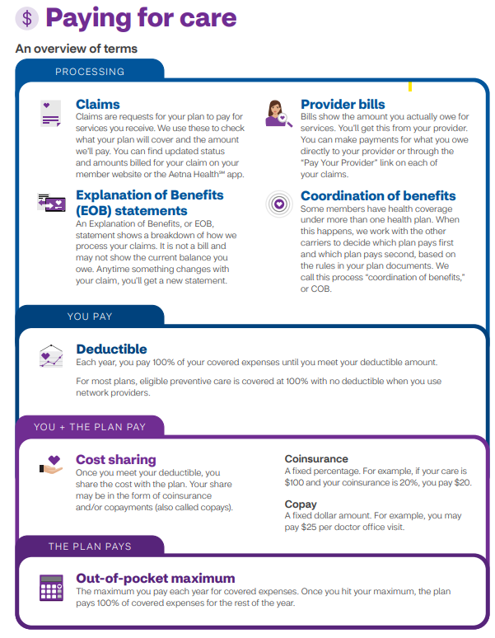

Slide 5
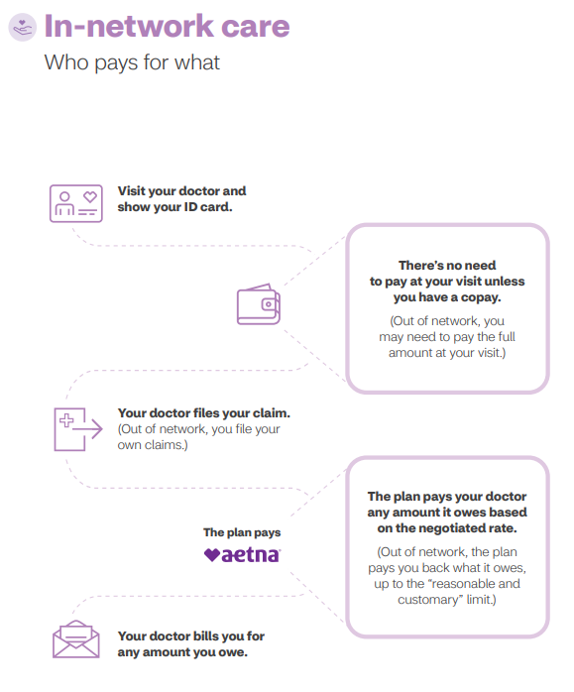

Slide 6
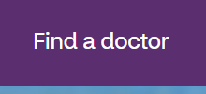

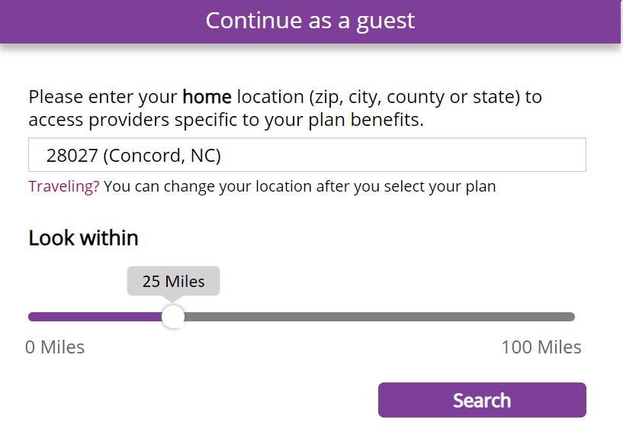
Provider Search
Log onto your secure Aetna member portal, or
Log on as a guest:
www.aetna.com
Click Find a doctor at the top:
Scroll down and to the right click on Plan from an employer:
Enter zip code at continue as a guest and click search:

Slide 7
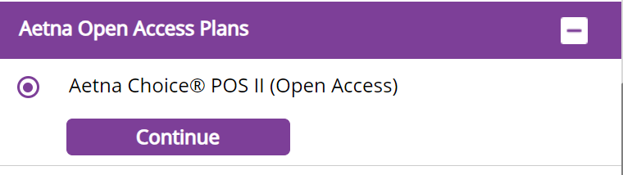
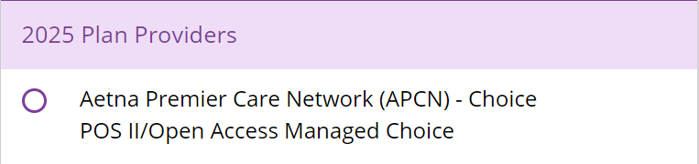
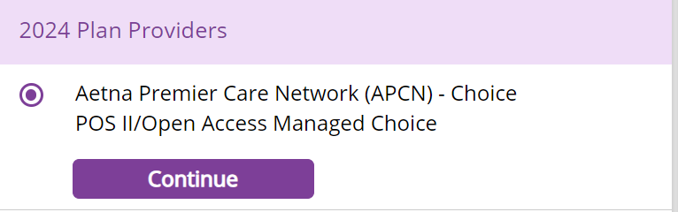
Provider Search
Select a Plan:
Non-HPN Plans: Scroll down to Aetna Open Access Plans and click on Aetna Choice POSII (Open Access) and continue
HPN Plans: Scroll down to Aetna Premium Care Network (APCN) – Choice POS II/Open Access Managed Choice
and select 2024 or 2025 providers and continue

Slide 8
Take care of yourself with preventive care
In-network
coverage
Stay healthy by taking advantage of your preventive care benefits. It’s the ultimate self-care with no out-of-pocket costs.
Qualifying immunizations
100%
Preventive care and screenings for infants, children and adolescents
100%
Well-women exams
100%
Notes:
PRESENTER: Fill in the table with plan-specific information. The information shown is an example only.

Slide 9
A high-deductible health plan (HDHP) can mean savings for you
Preventive care at 100% | Preventive care
You pay 100% until you meet the deductible | Deductible
 | Plan provisions kick in
The plan pays 100% after you meet your out-of-pocket maximum | Plan pays
Out-of-pocket maximum
Notes:
You have a high-deductible health plan (HDHP). As always, preventive costs from in-network providers are covered at 100%. You’re protected from catastrophic costs by the out-of-pocket maximum. After you meet the out-of-pocket maximum, your plan pays 100%.

Slide 10
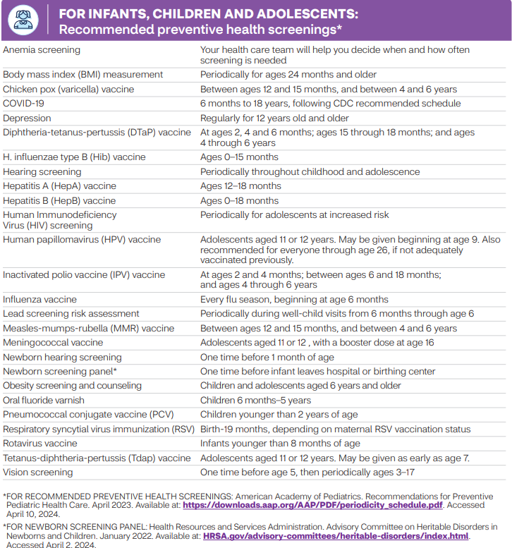
Preventive Care
Follows US Preventive Services Taskforce A and B grade recommendations

Slide 11
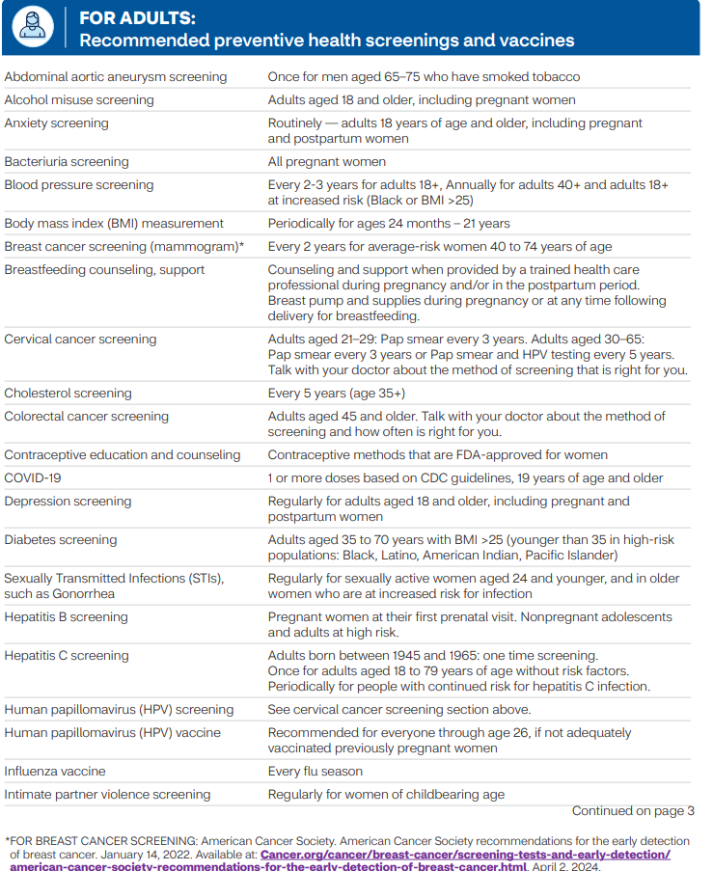
Preventive Care
Follows US Preventive Services Taskforce A and B grade recommendations

Slide 12
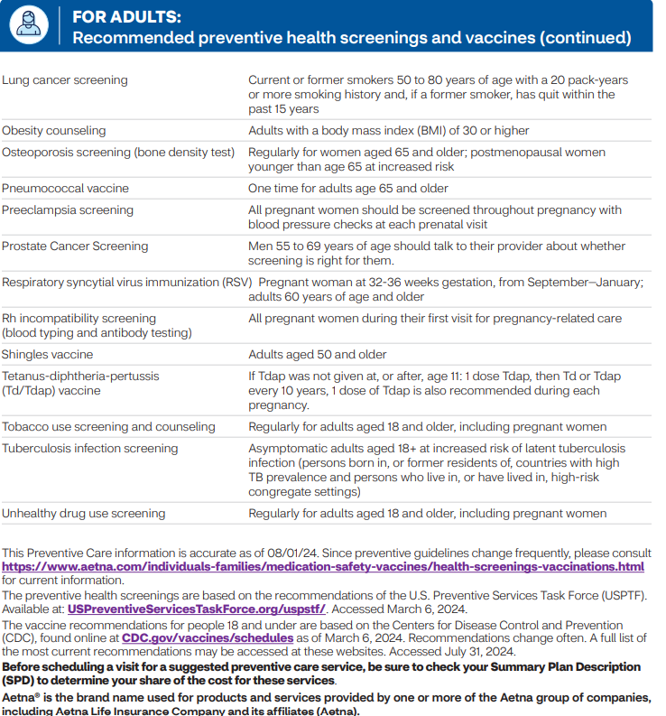
Preventive Care
Follows US Preventive Services Taskforce A and B grade recommendations

Slide 13
New for 2025
• Hearing Aids: $1,000 lifetime maximum increased to $2,000 lifetime maximum
• Acupuncture: Specialist cost share with a 20-visit calendar year maximum
• Enhanced Infertility : Diagnosis & treatment of underlying medical condition, including artificial insemination.
• ART: Advanced Reproductive Technology, including 3 cycles of ovulation induction and 3 cycles of IVF
• Blood & Blood Products: Aetna’s standard blood benefit has been enhanced to include coverage for blood and blood products when purchased by a facility / provider
• Aetna Health Your Way Core Benefit - Health Assessment and Digital Support
• Hinge Health – Aetna Back and Joint

Slide 14
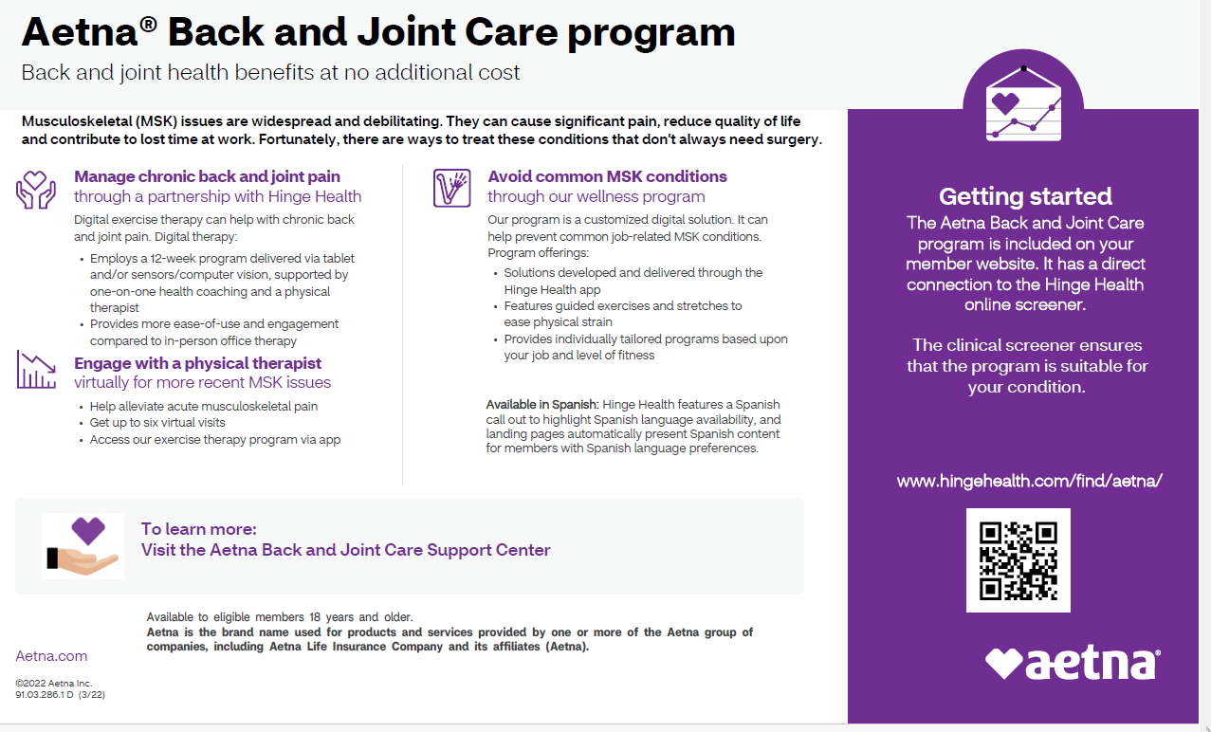

Slide 15

Easy-to-use coverage
with the Aetna Dental® PPO plan
In network or out — it’s your choice
Your options
How it works
In-network
Visit a dentist in the Aetna Dental PPO network.
To find one, use our online directory at Aetna.com
Network dentists offer special rates for covered services. So, your share of the cost is usually lower.
Network dentists file claims for you.
Out-of-network
Visit any licensed dentist outside the network.
You may pay more when you get care from dentists who aren’t in the network.
You may have to file your own claims.
Notes:
Dental care is about more than just healthy teeth and gums. Research shows that oral health and total-body health are connected. Gum disease is actually linked to conditions in the body, like heart disease, diabetes and even preterm birth. Research points to inflammation as the culprit.* So our benefits, service and support help ensure you have the dental care you need to stay healthy, happy and productive.
Our digital tools for dental members help you take control of your oral health
Search for dentists based on name, location or specific condition/procedure
View member-sourced reviews and ratings to help you make your choice
See the actual costs you can expect from procedures and services based on your plan
Receive reminders to get care and make appointments online with participating providers
You can access these tools through your member website at aetna.com.
*http://perio.org/consumer/gum-disease-and-other-diseases

Slide 16
Other dental services
Alternative orthodontics*
We partner with online vendors to provide certified, convenient orthodontic solutions.
Providers oversee remote treatment management and guidance from beginning to end — no in-person appointment needed.
Supplies are delivered directly to members’ homes.
Tele-dentistry
Members can connect remotely with dentists through a
“virtual visit” via Zoom, Facetime or Skype.
Dental providers can facilitate routine and/or oral evaluations
of their patients, answer questions, provide advice, prescribe appropriate medication and refer patients to specialists as needed.
For any oral evaluation covered under our dental plans, the
tele-dentistry benefit is the same as traditional dental care, according to your plan design.
*For those with PPO plans that cover orthodontia.
Notes:
Teledentistry:
If a member’s existing provider is not available or does not offer tele-dentistry, customer service is available to assist members in identifying the right provider.
Tele-dentistry minimizes unnecessary visits to the emergency room, travel time and transportation cost, as well as time away from work or school.

Slide 17

Aetna Enhanced Maternity ProgramTM
You can count on us for support — wherever you are in your maternity journey.
Special program features include:
A fertility advocate* to be your care manager
and provide support if you’re facing infertility
Predictive data to help us identify pregnancies early on so we can provide timely, more responsive outreach to you
Preeclampsia prevention by providing education and resources, if needed
Guided genetic counseling and screening
services, backed by medical expertise
Education and resources to help close racial
gaps in health care and support women of color
This program supports all women throughout their entire experience, whether they have
risk factors or not.
*While only your doctor can diagnose, prescribe or give medical advice, our fertility advocates/care managers can provide information on a variety of maternity-related topics.

Slide 18

Aetna Maternity Program
This program is part of your plan — there’s no extra cost to you. By participating in this program, you’ll learn more about:
What to expect before and
after delivery
Early labor symptoms
Newborn care
Breastfeeding, and more
Giving you and your baby
a healthy start
And if you have certain risk factors, you’ll also get special support to help avoid an
early delivery.
More features on your member website
You’ll have access to the Maternity Support Center.* On the site, you’ll get helpful tools and resources, information about pregnancy stages, personalized benefit details and more.
*Our maternity program and support teams do not diagnose or treat members. We assist you in getting the care you need, and our
program is not a substitute for the medical treatment and/or instructions provided by your health care providers.

Slide 19
Feeling your best
Living with a
behavioral health condition
Whether your condition is mild and short-lived or serious and long-lasting, there are effective treatments that can help.
Behavioral therapy
Behavioral therapy is one of the main ways to treat a behavioral health condition. Also known as talk therapy, it can help you identify issues in your life that can contribute to problems and teach you how to manage and move beyond those issues.
Medication therapy and management
Treatment may include taking prescription medications that are effective in treating conditions like depression and substance use disorders. Your doctors are trained to find the medications for you.
Your care advocate
They’ll work closely with you to support your emotional health and everyday needs. They can do all the legwork to help you give your emotional health the high priority it deserves.
People of any age, gender, income,
race or religion can be affected by:
Anxiety
Depression
Eating disorders
Substance use disorders
That’s why your medical plan includes behavioral health benefits
We’ve integrated your benefits so that you can take care of the whole you.
So, whether you choose face-to-face counseling or prefer televideo counseling, you get convenient access to care, support and other resources — wherever you are.
Notes:
Main message: Taking care of your mental health is just as important as your physical health. Many people live with a behavioral health condition that can affect how they think, feel and act. There are effective treatments that can help. But the condition must be diagnosed first. Your medical plan includes behavioral health benefits to address these conditions. That means we’re here with the help and resources you need to work toward feeling your best.
Getting treatment
Behavioral therapy [counseling and psychotherapy] also known as talk therapy can help you identify issues in your life that can contribute to problems and manage and move beyond those issue
Medication therapy and management: It’s important to take your medications how your doctor prescribes them even if you feel better. If not, symptoms can return. We can help you learn more about your medications, how they work and why they’re important.
Your care advocate can do all the legwork to help you give your emotional health the high priority it deserves. They can provide guidance and support, better access to quality care and caregiver support.
The role of your doctor
Your primary care doctor is an important ally in your recovery. They are often the first person to realize you need help. That’s why it’s important to be open about how you feel and any emotional issues you struggle with. So make sure to stay in touch with your doctor throughout your treatment.

Slide 20
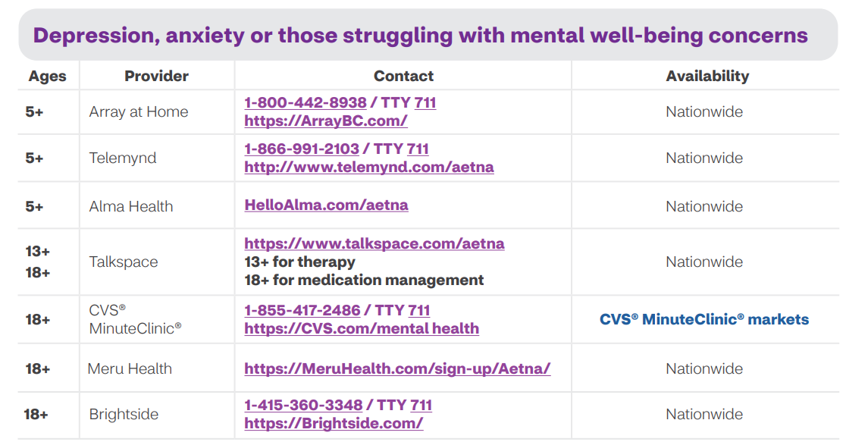

Slide 21
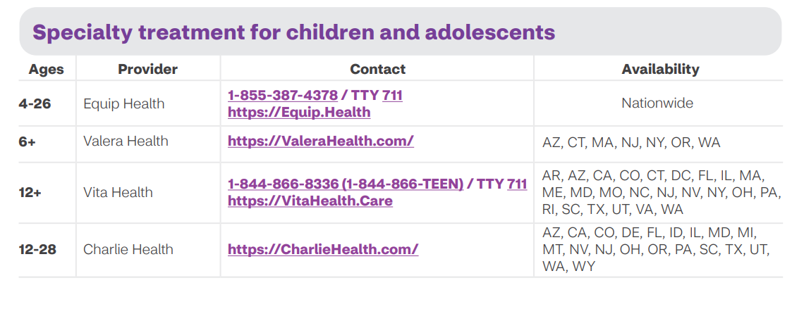

Slide 22
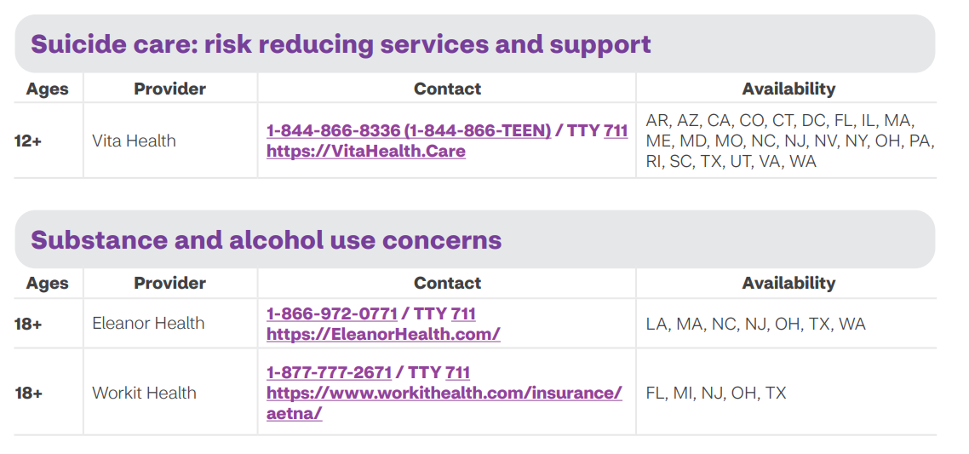

Slide 23
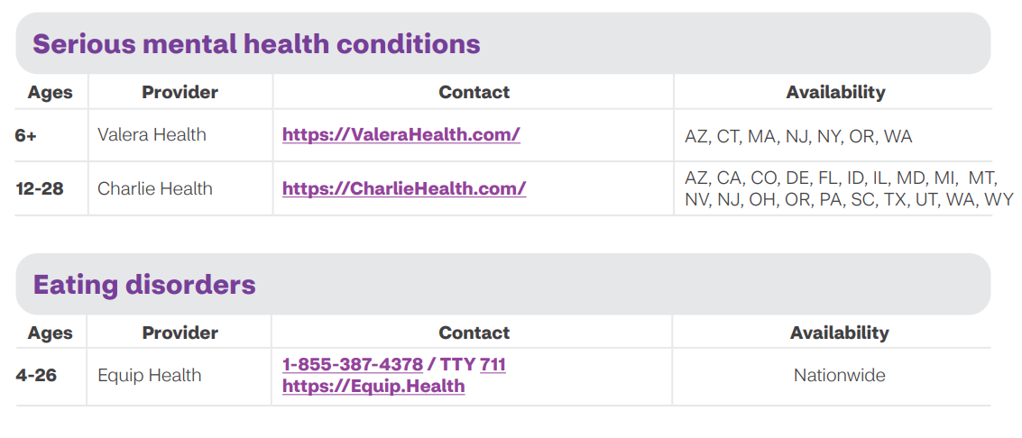

Slide 24

You’ve got this
An easier experience can make you happy and healthier.
Notes:
We want to take the frustration out of health care and help you get what you want, when you want it, how you want it.
Here’s how we do it.

Slide 25

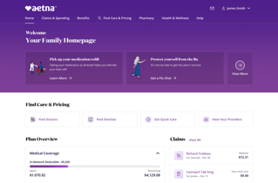

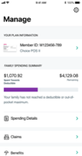

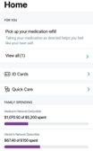
Take charge of your health care
with the Aetna® member website and the Aetna Health℠ app
Find everything you need, all in one place
Set up your account to manage your benefits and more at home or on the go.
A smarter, simpler, more convenient way to take charge of your health care and benefits
Manage your plan
Check your plan summary
for detailed information on what’s covered by your plan.
Track your spending and understand your progress
toward meeting your individual and family deductibles.
Easily access your digital ID card anytime.
Connect to care
Use tools to help you choose quality, in-network and local providers, pharmacies and facilities, including convenient retail clinics and urgent care.
Get cost estimates for visits and procedures before getting care.
Talk to a doctor anytime by phone or video chat from home.
Download the
Aetna Health app
View claims
Check up to two years of claims for your whole family.
Pay claims.
Improve your health
Receive personalized reminders to improve your health.
Just visit Aetna.com to create an account
and log in to your member website.
App screens are a composite of real situations.
All names and other identifying information are fictional.
Notes:
PRESENTER: Customize based on plan
Whether you use the Aetna member website or the Aetna Health app, our tools help power your decisions. They can help you find the choose the right care at the right cost. And so much more.
Find Care
Intuitive search to find and compare in network doctors.
Access to your digital ID card when you need it.
Cost tools:
Compare costs between providers and facilities. Costs reflect your health plan.
View claims details, track and pay claims online.
Quality and cost:
View and understand plan coverage and benefits details.
Information to help make more informed decisions about treatment options.
Plus, we’ve learned that you can’t just build something, put it on a shelf and leave it as is. You have to invest and iterate on an ongoing basis. That’s why we update the app regularly with new features. This helps us stay current and ensure our members (your employees) have access to the latest features and functionality.

Slide 26

24-Hour
Nurse Line
Health information is a phone call away
Get information on a wide range
of health and wellness topics
Make better health care decisions
Find out more about a medical
test or procedure
Get help preparing for a visit
to your doctor
Receive emails with links to videos related to your question or topic
Notes:
Sometimes your health question can’t wait until your doctor visit. Or even the next morning. With the 24-Hour Nurse Line, you can speak to a registered nurse about health issues that are on your mind — whenever you need to. Of course, only your doctor can diagnose, prescribe or give medical advice. But the 24-Hour Nurse Line nurses can provide information on more than 5,000 health topics. They can help you save a trip to the emergency room or make smarter decisions about your health care.
Plus:
• It’s toll-free.
• You can call as many times as you need — at no extra cost.
• Your covered family members can use it, too.
The 24-Hour Nurse Line can provide helpful information and possibly prevent an unneeded trip to the emergency room. That can be a money saver. Plus, you’ll be able to make smarter health decisions. You’ll have reliable information you can trust — and it’s only a phone call or click away.
Remember to contact your doctor first with any questions or concerns regarding your health care needs.

Slide 27



Talk to a doctor anytime, anywhere
24/7 access to a doctor by phone or video
Talk to a doctor from your home*
Available
anytime, anywhere**
$56 or less
per visit
*Teladoc can answer questions about the virus, assess your risk, and provide support to help relieve symptoms.
Due to COVID-19, the need for our care has never been greater and wait times can be a few hours.
**Idaho is video only; Arkansas and Delaware require video for first visit every 24 months.
Optional for self-funded plans.
Notes:
Virtual care from highly qualified physicians and practitioners. It is there for people when they need it. It’s private, convenient and affordable. Whether it’s from one of our network providers, telemedicine provider, video visits through a MinuteClinic or remote monitoring, we’re expanding these ways to help people on their path to better health.
Note - optional for self-funded plans

Slide 28

Get low cost/no-cost care* at MinuteClinic® locations
MinuteClinic services
Minor illnesses and injuries, like allergies, ear infections, flu-like symptoms, bug bites, stings and more
Skin conditions
Wellness and physicals
Screenings and monitoring
Vaccinations and injections
Travel health
Women’s and men’s health services
Obstructive sleep apnea** screening assessment and diagnosis
Point of care lab testing​
MinuteClinic providers can also write prescriptions, when medically appropriate.
For your best health, we encourage you to have a relationship with a primary care physician or other doctors. Tell them about your visit to MinuteClinic, or MinuteClinic can send a summary of your visit directly to them.
** Sleep apnea screening performed by MinuteClinic.
Your MinuteClinic provider may prescribe a home sleep test, sleep test interpretation and diagnosis by an independent third party.
Access convenient, local care
at MinuteClinic locations inside select CVS Pharmacy® and Target® stores.
Find help when you need it,
including nights and weekends.
Get the care you deserve,
without the high out-of-pocket costs.
* Applies only to covered services at MinuteClinic®. Video visits are not a covered service under this visit. Members in indemnity plans are not eligible for this benefit. Such members should refer to their benefit plan documents in order to determine coverage and applicable cost share for clinic benefits and services, as applicable. Visit MinuteClinic.com for age and service restrictions.
The no-cost MinuteClinic benefit is not currently available to HMO membership in California, Sutter joint venture membership in California and members in the Indemnity plans are not eligible. Includes select MinuteClinic® services. Not all MinuteClinic services are covered. Please consult benefit documents to confirm which services are included. Members enrolled in qualified high-deductible health plans must meet their deductible before receiving covered non-preventive MinuteClinic services at no cost-share. However, such services are covered at negotiated contract rates. This benefit is not available in all states or on indemnity plans.
28
©2023 Aetna Inc.
Notes:
Sometimes things just happen. Your kid develops flu symptoms after your primary care office has closed for the day. You step on a tack over the weekend. We get it, things happen, and when they do, you want to be able to access care at a price you can afford. That’s why we’re offering a perk to eligible Aetna members: access to all covered MinuteClinic services at no cost to you, or low cost to you, based on your plan design.*
MinuteClinic is a walk-in clinic inside select CVS Pharmacy® and Target® stores and is the largest provider of retail health care in the United States, making it easy to access care in your neighborhood.
Open seven days a week, including evenings and weekends. You can walk in or schedule appointments online beforehand. And for even more convenience, you can pick up your prescription on-site.
*Applies only to covered services at MinuteClinic. Video visits are not a covered service under this benefit. This information does not apply to members enrolled in qualified high-deductible health plans: such members must meet their deductible. However, such services would be subject to negotiated contract rates. Once the deductible has been met, such members will be able to access MinuteClinic services at no cost-share. Members in indemnity plans are not eligible for this benefit. Such members should refer to their benefit plan documents in order to determine coverage and applicable cost share for walk-in clinic benefits and services, as applicable. Visit MinuteClinic.com for age and service restrictions.

Slide 29

CVS® HealthHUB™ locations
A convenient and affordable option
to help get you on the path to better health.
Convenient
Open every day, including nights and weekends. Get the care you need on your schedule.
Affordable
Just use your Aetna® benefits and get care.
MinuteClinic® services
Expanded MinuteClinic services available**
Minor illnesses and injuries
Skin conditions
Wellness and physicals
Screenings and monitoring
Vaccinations and injections
Travel health
Women’s and men’s health services
Obstructive sleep apnea* screening assessment and diagnosis
Point of care lab testing​
Support managing certain chronic conditions like diabetes, sleep apnea, high cholesterol and more
Diabetic services like diabetic retinopathy screening and imaging***
Lifestyle support for heart health
Pelvic exams, STI testing and more
Colorectal risk assessment
Chickenpox vaccination (Varivax®)
Your local MinuteClinic
may now be a CVS HealthHUB.
Visit CVS.com/HealthHUB
to find a location near you.
* Sleep apnea screening performed by MinuteClinic. Your MinuteClinic provider may prescribe a home sleep test, sleep test interpretation and diagnosis by an independent third-party.
** Clinical services provided by a MinuteClinic nurse practitioner or physician assistant within a CVS HealthHUB location.
***Diabetic retinopathy diagnosis by an independent provider.

Slide 30
Go to your
member website and take
a health risk assessment.
Answer
Learn
Spend fewer
than 15 minutes
answering questions.
Find “aha” moments along the way with easy-to-follow pieces of health information.
Discover
Engage
Explore a health action plan that’s personalized for you.
Choose your next steps toward feeling better now.
Notes:
In 15 minutes or fewer, you can take the first step to improve your health. Just complete a simple health assessment. It asks you questions about your health history and habits.
It’s easy to get there. Just:
Log in to or register for your Aetna member website at Aetna.com.
Click on the “Stay Healthy” tab.
Choose the “Take a health assessment” link or “Discover a Healthier You” link.
(yes, even with your busy schedule!)

Slide 31

Online health coaching for healthy changes that last
Be tobacco-free
Manage diabetes
Have a healthy back
Get heart healthy by managing cholesterol
Stress less
Manage weight
Live well with asthma
Eat healthier
Notes:
It can be hard to fit healthy into your life. But we’re here to support you every step of the way. You get a choice of digital coaching programs included with your health plan. All online, all personalized to your health goals. Whether you’re managing a health risk, overcoming an old habit or just eating healthier. You choose the goals to work on.
Here are some of the online coaching programs available:
• Be tobacco-free
• Manage diabetes
• Have a healthy back
• Get heart-healthy by managing cholesterol
• Stress less
• Weigh less
• Live well with asthma
• Eat healthier
Each coaching program is broken up into simple steps. So you can reach small victories on your way to the grand prize: a healthier you. You’ll find realistic recommendations within each program. Like adding 15 minutes to your daily walk or not smoking for just 1 day. You choose the goals and when to work on them. You can even pause, restart or retake a program. Whatever you need to reach your healthiest you.

Slide 32

Count on savings with the Aetna® Discount Program*
Fitness
Books
Natural products and services
Oral health
Hearing
Weight management
Vision
At-home products
Fitness
Books
Natural products and services
Oral health
Hearing
Weight management
Vision
At-home products
* Discount programs are NOT insurance and program features are not guaranteed under the plan contract and may be discontinued at any time. Discount programs are in addition to any plan benefits and may require a separate charge to access such programs. Discount programs are NOT available to New York policyholders.

Slide 33

Money-saving tips while you get healthy
Use urgent care centers for
nonemergency, after-hours care
Use your preventive benefits — get recommended screenings and checkups
Consider using generic drugs,
if appropriate
Use cost tools on your member
website to make smart choices
Notes:
Here are a few things you can do to be a smarter health care consumer. You’ll make the most of your benefits, and you can save money, too.

Slide 34
Transforming your welcome experience with a personalized and unique smart video
1
Offers a personalized introduction to your plan
and the benefits unique to you — in under five minutes
2
Provides specific dollar values for deductibles,
out-of-pocket maximum, fund balances and more
Transforming
your welcome experience
with a personalized
and unique smart video
3
Highlights extra plan benefits, such as discounts and preventive care
4
Updates in real time as you use your plan
5
Allows you to sit back and relax because it’s
all about you. See a sample video here.

Slide 35
Q&A
35
©2023 Aetna Inc.

Slide 36
Thank you!

Slide 37
This material is for information only. Providers are independent contractors and are not agents of Aetna. Provider participation may change without notice. Aetna does not provide care or guarantee access to health services. Not all health services are covered. See plan documents for a complete description of benefits, exclusions, limitations and conditions of coverage. Plan features and availability may vary by location and are subject to change.
Discounts for non-covered dental services may not be available in all states. Providers participating in the Aetna Vision network are contracted through EyeMed Vision Care, LLC. EyeMed and Aetna are independent contractors and not employees or agents of each other. Participating vision providers are credentialed by and subject to the credentialing requirements of EyeMed. Aetna does not provide medical/vision care or treatment and is not responsible for outcomes. Aetna does not guarantee access to vision care services or access to specific vision care providers and provider network composition is subject to change without notice. Vision insurance plans contain exclusions and limitations. Not all vision services are covered.
Health information programs provide general health information and are not a substitute for diagnosis or treatment by a physician or other health care professional. Health benefits and health insurance plans contain exclusions and limitations.
Aetna, CVS Pharmacy® and MinuteClinic, LLC (which either operates or provides certain management support services to MinuteClinic-branded walk-in clinics) are part of the CVS Health family of companies.
©2022 Teladoc, Inc. All rights reserved. Teladoc® is not available to all members. Teladoc and Teladoc physicians are independent contractors and are not agents of Aetna. Visit Teladoc.com/Aetna for a complete description of the limitations of Teladoc services. Teladoc, Teladoc Health and the Teladoc Health logo are registered trademarks of Teladoc Health, Inc.
Information is believed to be accurate as of the production date; however, it is subject to change.
For more information about Aetna plans, refer to Aetna.com.
Policy forms issued in Idaho by Aetna Health of Utah Inc. include: HI ID GrpAg 05, HI SG HGrpAg 03.
Policy forms issued in Idaho by Aetna Life Insurance Company include: GR-29/GR-29N, AL HGrpPol 05, AL HGrpPol-Vision 01.
Policy forms issued in Oklahoma include: AL COC00010, HC COC00010, AL-HCOC-Dental PPO 04, AL HCOC-Dental CD04,AL HCOC Vision AVP01.
Policy forms issued in Missouri include: AL HGrpPol 01R5, HI HGrpAg 05, HO HgrpPol 04, AL HGrpPol-Vision 01, AL HGrpPol-Dental 01, DM HGrpAG-Dental 02.
XXXXXXXXXX (X/22)

Slide 38
©2023 Aetna Inc.
XXXXXXXXXX (X/223

